Slide 1
Muscle Sensing Game Controller

Slide 2
hello!
Team RoRo
Apurba Adhikary (Team Leader)
Bibidh Bista
Rahul Shrestha

Slide 3
Idea
Harnesses the power of electromyography to allow players to directly control video games with their muscles.

Slide 4
Big concept
Arduino UNO microcontroller, a favorite among hobbyist and students, acting as a HID keyboard interface.
Integrated with the Arduino UNO are Muscle (EMG) Sensors, allowing muscles to act independently or in combination with each other to control different buttons.
Use it to play any computer game (that uses keyboard inputs) using your muscles as the controller.

Slide 5
Relation
Power Supply
Muscle Sensor
Arduino Uno R3

Slide 6
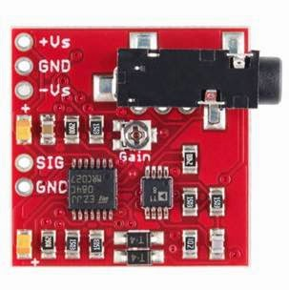
Muscle Sensor
This sensor will measure the filtered and rectified electrical activity of a muscle; outputting 0-Vs Volts depending the amount of activity in the selected muscle, where Vs signifies the voltage of the power source.

Slide 7
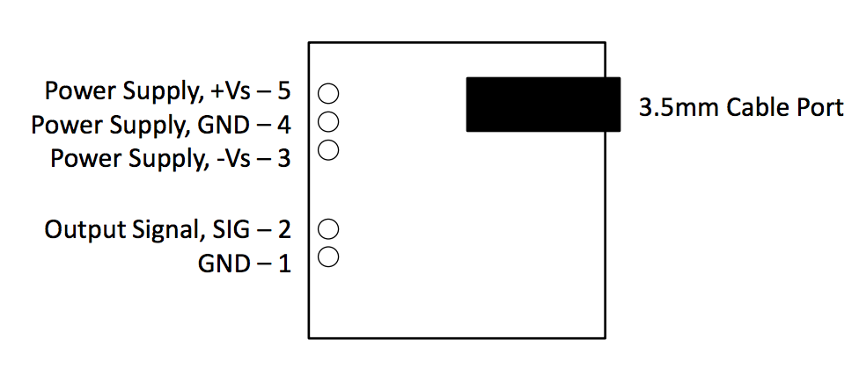
Schematic Diagram of Sensor

Slide 8
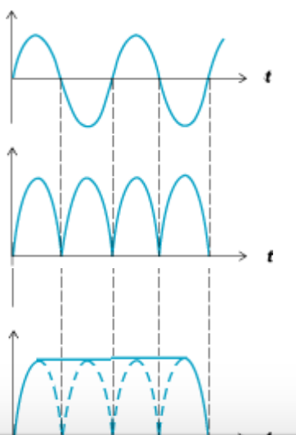
RAW Sine Wave
Full Wave Rectified Sine Wave
Rectified & Smoothed Sine Wave

Slide 9
Software(s) Used
Arduino IDE
Processing

Slide 10
thanks!
Any questions?

